Slide 1


Project Presentation:
Impact of Surprise
Group One
Zhibai Luo, Zicheng He, Yulin Wu,
Xiangjun Kong, Tianzi Zheng
2019-12-17

Slide 2
Project Design

Slide 3
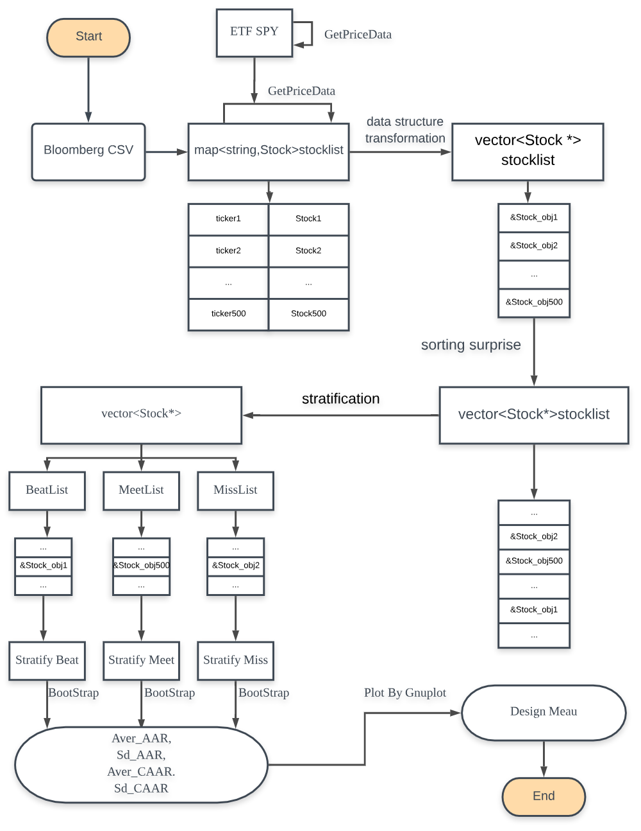

Slide 4
Class Declaration & Data Structures

Slide 5
Class Declaration & Data Structures
class Stock
private:
public:
- string name;
- string ticker;
- string date; //releasing date
- double actual;
- double estimate;
- double surprise;
- vector<double> price;
- vector<double> AR;
- vector<double> StockReturn;
- vector<double> SPYReturn;
- vector<string> ReturnDates;
- string StartDate;
- string EndDate;
- string Group;
+ map<string, Stock>
+ getBloomberg(string myFile);
+ void PullStockInfo();
+ string getDate();
+ double getSurprise();
+ void Setprice(vector<double>&);
+ void SetReturn();
+ vector<string>
GetStartEndDates(vector<string>&);
+ vector<double> getAR()
+ void SetAR(ETF& spy);
+ void SetGroup(string str_)
+ vector<double> getPrice()

Slide 6
Class Declaration & Data Structures
class ETF
private:
- vector<string> date;
- vector<double> price;
- vector<double> Return;
public:
+ const vector<string>& GetDateVector();
+ const vector<double>& GetReturnVector();
+ void SetDate(vector<string>&);
+ void SetPriceReturn(vector<double>&);

Slide 7
Class Declaration & Data Structures
class stratify
private:
- vector<double> Aver_AAR, Sd_AAR, Aver_CAAR, Sd_CAAR
- vector<Stock*> vstock; //vector of Stock*
- int group_size;
- string group_name;
public:
+ stratify(vector<Stock*>& vstock_, string group_name_); //constructor
+ stratify() {}; // default constructor
+ vector<double> OneSample(); //generate one bootstrap-sample
+ void BootStrap(); //call function-OneSample 30 times
+ vector<double> Get_Aver_CAAR();
+ void PullGroupInfo();

Slide 8
Bloomberg Data & Initialize Stock Map

Slide 9
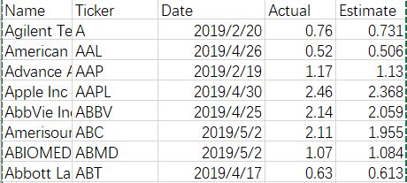
Bloomberg Data & Initialize Stock Map
The SP500 Stocks Data CSV File
Get Estimate EPS (example):
=BDP(B3, "BEST_EPS", "BEST_FPERIOD_OVERRIDE", "-3FQ")
Get Real EPS (example):
=BDP(B2, "IS_COMP_EPS_ADJUSTED", "EQY_FUND_RELATIVE_PERIOD", "-3FQ")
Then we rearrange the csv file and use Python to choose the price which has an announce data closest to 3.31 (example):

Slide 10
Get SP500 Stocks Data from Bloomberg CSV File
map<string, Stock> Stock::getBloomberg(string myFile)
{
string line;
map<string, Stock> stock;
ifstream in(myFile); // read myFile into fstream "in"
if (in)
{ string firstLine;
getline(in, firstLine); //skip first line
while (getline(in, line))
{
Stock info;
regex comma(",");
vector<string> v(sregex_token_iterator(line.begin(), line.end(),
comma, -1), sregex_token_iterator()); //split using comma
info.name = v[0];
info.ticker = v[1];
info.date = v[2];
info.actual = stod(v[3]);
info.estimate = stod(v[4]);
info.surprise = (info.actual - info.estimate) / info.estimate;
stock.insert({ v[1], info });
}
in.close(); return stock;
} else{cout << "The file" << myFile << "could not open" << endl;}
}

Slide 11
Get SP500 Stocks Data from Bloomberg CSV File
Class Stock （now we have）
- string name, ticker, data;
- double actual, estimate, surprise;
+ map<string, Stock> getBloomberg(string myFile);
+ double getSurprise();
+ string getDate();

Slide 12
Retrieve historical price with Libcurl

Slide 13
MyCurl.cpp
In this function, we use libcurl to crawl data from Yahoo Finance
Pass the Stock Map we get from CSV file and also the Benchmark Object, whose price data are also needed to get from Yahoo Finance
int GetPriceData(map<string, Stock>& StkMap, ETF& Benchmark)
{
//First construct 4 vectors
vector<double> price;
vector<string> SPYDatesList;
vector<string> symbolList;
vector<vector<string>> startEndDatesList;
//Fill up SymbolList with the Stock Map
for (map<string, Stock>::iterator itr = StkMap.begin(); itr != StkMap.end(); itr++)
{
symbolList.push_back(itr->first);
}
//Initialize two iterators, for symbolList and Stock Map
vector<string>::iterator itr_symbol = symbolList.begin();
map<string, Stock>::iterator itr_map = StkMap.begin();

Slide 14
MyCurl.cpp (Cont.)
The first step is to get the data of the benchmark, which in our project is S&P 500, so we directly give our program the symbol name ("^GSPC")and data time period (From 18-12-7 to 19-7-15)
string symbol = "^GSPC";
…
startTime = getTimeinSeconds(("2018-12-07T16:00:00"));
endTime = getTimeinSeconds(("2019-07-15T16:00:00"));
Set the Price, Return and Date in our ETF object Benchmark, with the data we get from Yahoo
while (getline(sData, line)) {
…
SPYDatesList.push_back(sDate);
price.push_back(dValue); }
Benchmark.SetDate(SPYDatesList);
Benchmark.SetPriceReturn(price);

Slide 15
MyCurl.cpp (Cont.)
for (map<string, Stock>::iterator itr = StkMap.begin(); itr != StkMap.end(); itr++)
{
startEndDatesList.push_back(itr->second.GetStartEndDates(SPYDatesList));
}
vector<vector<string>>::iterator itr_date = startEndDatesList.begin();
cout << "BenchMark Ready." << endl;
It’ s a vector of vector, including all the StartDates and EndDates for all the stocks.
It’ s a member function of Stock, find the Start and End for the stock according to the SPYDateList
auto itr1 = find(BenchmarkDate.begin(), BenchmarkDate.end(), date);
Stock.Date
Day30
Day-30
Day0
push_back(*(itr1 + 30));
push_back(*(itr1 + 30));
SPYDatesList

Slide 16
MyCurl.cpp (Cont.)
while (true)
{
free(data.memory);
data.memory = NULL;
data.size = 0;
if (itr_symbol == symbolList.end() or itr_map == StkMap.end()) break;
string symbol = *itr_symbol;
…
startTime = getTimeinSeconds(((*itr_date)[0] + "T16:00:00"));
endTime = getTimeinSeconds(((*itr_date)[1] + "T16:00:00"));
With the symbol in symbolList, StartDate and EndDate in startEndDatesList, we can get the price from Yahoo

Slide 17
MyCurl.cpp (Cont.)
for (; getline(sData, line); )
{
line = line.erase(line.find_last_of(','));
line = line.substr(line.find_last_of(',') + 1);
try {
price.push_back(stod(line)); //string to double
}
catch (...) {continue;}
}
itr_map->second.Setprice(price);
}
…
itr_symbol++;
itr_date++;
itr_map++;
After getting the price, we set then into the Stock Map. And then turn to next stock.

Slide 18
Stratification & Calculation

Slide 19
void Stratify_Calculate_Bootstrap(map<string, Stock>& stock_map_, ETF& spy,
stratify& Beat, stratify& Meet, stratify& Miss)
{
// 1. data structure transformation
vector<Stock*> stocklist;
for (auto it = stock_map_.begin(); it != stock_map_.end(); it++)
{ stocklist.push_back(&(it->second)); }
// 2. sorting surprise
sort(stocklist.begin(), stocklist.end(), cmp_by_value);
// 3. stratify objects initialization
vector<Stock*> BeatList, MeetList, MissList;
int itcount = 0;
for (auto it = stocklist.begin(); it != stocklist.end(); it++, itcount++)
{
if (itcount < 109) // first 109 SPY stocks have negative surprise
{ MissList.push_back(*it); (*it)->SetGroup("Miss"); }
else if (itcount < 261) // 110-261 SPY stocks have positive surprise smaller than 0.05
{ MeetList.push_back(*it); (*it)->SetGroup("Meet"); }
else // other SPY stocks have positive surprise larger than 0.05
{ BeatList.push_back(*it); (*it)->SetGroup("Beat"); }
// 4. AR calculation
(*it)->SetReturn();
(*it)->SetAR(spy);
}
Beat = stratify(BeatList,"Beat"); Meet = stratify(MeetList,"Meet"); Miss = stratify(MissList,"Miss");
// 5. Bootstrap
Beat.BootStrap(); Meet.BootStrap(); Miss.BootStrap();
}

Slide 20
Stratification & Calculation
map<string, Stock> stocklist
vector<Stock *> stocklist
“ticker1” | Stock_obj1
“ticker2” | Stock_obj2
… | …
“ticker500” | Stock_obj500
1. data structure
transformation
&Stock_obj1
&Stock_obj2
…
&Stock_obj500
Surprise = 0.06
Surprise = -0.04
Surprise = 0.04
2. sorting surprise
// compare Stock* based on surprise in Stock object
bool cmp_by_value(Stock*& lhs, Stock*& rhs)
{ return lhs->getSurprise() < rhs->getSurprise(); }
// sort function comes from <algorithm>
sort(stocklist.begin(), stocklist.end(), cmp_by_value);
vector<Stock *> stocklist
vector<Stock *>
…
&Stock_obj2
…
&Stock_obj500
…
&Stock_obj1
…
Surprise = -0.04
BeatList
MeetList
MissList
3. stratification
…
&Stock_obj1
…
…
&Stock_obj500
…
…
&Stock_obj2
…
Surprise = 0.04
Surprise = 0.06

Slide 21
Stratification & Calculation
// 4. AR calculation
A technique to find the SPY return over a specific stock’s date range:
ETF object
vector<string> SPY_date = spy.GetDateVector();
Begin() |  |  |  | Find( ) |  |  |  |  | end()
itr_date
auto itr_date = find(SPY_date.begin(), SPY_date.end(), StartDate);
vector<double> SPY_return = spy.GetReturnVector();
Begin() |  |  | TARGET
itr_return
auto itr_return = SPY_return.begin() + (itr_date - SPY_date.begin()) - 1;

Slide 22
Class stratify
- vector<Stock*> vstock;
- string group_name;
- int group_size;
- vector<double> Aver_AAR, Sd_AAR, Aver_CAAR, Sd_CAAR
+ stratify();
+ stratify(vector<Stock*>& vstock_, string group_name_);
+ vector<double> OneSample();
+ void BootStrap();
+ void PullGroupInfo();
+ vector<double> Get_Aver_CAAR();

Slide 23
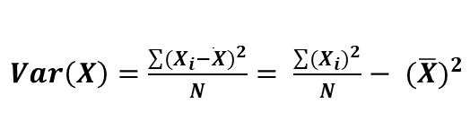
// 5. Bootstrap
vstock: vector<Stock*>, call by reference
vstock.at(id): Stock*
(vstock.at(id))->getAR(): vector<double>, call by pointer
//generate one bootstrap-sample
vector<double> stratify::OneSample()
{
vector<double> AAR = vector<double>(60, 0.0);
for (int i = 0; i < 30; i++)
{
int id = rand() % group_size; //random int between 0 and (group_size-1)
AAR = (i / (i + 1.0)) * AAR + (1 / (i + 1.0)) * ((vstock.at(id))->getAR());
}
return AAR;
}
//call function-OneSample 30 times
void stratify::BootStrap()
{
for (int k = 0; k < 30; k++)
{
vector<double> AAR = OneSample();
// CAAR is the cumulative sum of AAR
vector<double> CAAR(60, 0.0);
partial_sum(AAR.begin(), AAR.end(), CAAR.begin());
// step by step calculation for mean/variance
Aver_AAR = (k / (k + 1.0)) * Aver_AAR + (1 / (k + 1.0)) * AAR;
Aver_CAAR = (k / (k + 1.0)) * Aver_CAAR + (1 / (k + 1.0)) * CAAR;
Sd_AAR = (k / (k + 1.0)) * Sd_AAR + (1 / (k + 1.0)) * pow(AAR, 2.0);
Sd_CAAR = (k / (k + 1.0)) * Sd_CAAR + (1 / (k + 1.0)) * pow(CAAR, 2.0);
}
// final step calculation for standard deviation
Sd_AAR = pow(Sd_AAR - pow(Aver_AAR, 2.0), 0.5);
Sd_CAAR = pow(Sd_CAAR - pow(Aver_CAAR, 2.0), 0.5);
}
Class stratify
- vector<Stock*> vstock;
- string group_name;
- int group_size;
- vector<double> Aver_AAR, Sd_AAR, Aver_CAAR, Sd_CAAR
+ stratify();
+ stratify(vector<Stock*>& vstock_, string group_name_);
+ vector<double> OneSample();
+ void BootStrap();
+ void PullGroupInfo();
+ vector<double> Get_Aver_CAAR();
Operator overloading of +, -, *, /, pow
vector<double> operator+(const vector<double>& v1,
const vector<double>& v2)
{ int dimension = v1.size();
vector<double> w(dimension);
for (int j = 0; j < dimension; j++)
{ w[j] = v1[j] + v2[j]; }
return w;}
Stepwise Calculation of Mean and Variance
(Similar to Part 4 slides)
Notes:
$Var\left(X\right)=\frac{\sum{{(X_{i}−\overline{X})}^{2}}}{N}=$ $\frac{\sum{{(X_{i})}^{2}}}{N}−$ ${(\overline{X})}^{2}$

Slide 24
Gnuplot & Menu Design

Slide 25
Gnuplot & Menu Design
void plotResults(stratify& Beat_, stratify& Meet_, stratify& Miss_) {
vector<double> Beat_CAAR = Beat_.Get_Aver_CAAR();
vector<double> Meet_CAAR = Meet_.Get_Aver_CAAR();
vector<double> Miss_CAAR = Miss_.Get_Aver_CAAR();
//cout << "Debug: "<<Beat_CAAR.size() << endl;

Slide 26
Gnuplot & Menu Design
double* xData = (double*)malloc(60 * sizeof(double));
double* yData1 = (double*)malloc(60 * sizeof(double));
double* yData2 = (double*)malloc(60 * sizeof(double));
double* yData3 = (double*)malloc(60 * sizeof(double));

Slide 27
Gnuplot & Menu Design
for (int i = 0; i <= 59; i++) {
xData[i] = double(i);
yData1[i] = Beat_CAAR.at(i);
yData2[i] = Meet_CAAR.at(i);
yData3[i] = Miss_CAAR.at(i);
FILE* gnuplotPipe, * tempDataFile;
const char* BeatData = "Beat Group";
const char* MeetData = "Meet Group";
const char* MissData = "Miss Group";
double x1, y1, x2, y2, x3, y3;

Slide 28
Gnuplot & Menu Design
Quit=False
If input is invalid
“Invalid input”
Case1:Retrieve historical price data
Case2:Pull info of one stock
Case3:Show AAR, AAR-SD, CAAR and CAAR-SD of one grou
Case4: Draw plot
Case5: Exit
Quit=True
Switch

Slide 29
Gnuplot & Menu Design
switch (Response)
{
case '1':
if (PrepareData) { cout << "Historical price data for all stocks retrieved." << endl << endl << endl << endl; break; }
cout << "Retrieving historical price data for all stocks:" << endl;
t0 = clock();
stock_map = WebCrawler.getBloomberg("C:\\Users\\WilliamNG\\Desktop\\2019Q1_new.csv");
GetPriceData(stock_map, SPY500);
cout << "Historical price data for all stocks retrieved; time used: " << setprecision(3) <<
(clock() - t0) * 1.0 / CLOCKS_PER_SEC / 60.0 << " min" << endl << endl;
t0 = clock();
Stratify_Calculate_Bootstrap(stock_map, SPY500, Beat, Meet, Miss);
cout << "AAR and CAAR of all 3 groups calculated; time used: " << setprecision(3) <<
(clock() - t0) * 1.0 / CLOCKS_PER_SEC / 60.0 << " min" << endl << endl << endl << endl;
PrepareData = true;
break;

Slide 30
Gnuplot & Menu Design
case '2':
if (!PrepareData) { cout << "Please first retrieve historical price data." << endl << endl << endl << endl; break; }
cout << "Pull information of one stock:" << endl << "Please enter the ticker: ";
cin >> StrInput;
if (stock_map.count(StrInput) > 0)
stock_map[StrInput].PullStockInfo();
else
cout << "Invalid Input: Please re-enter your choice." << endl;
cout << endl << endl << endl;
break;

Slide 31
Gnuplot & Menu Design
case '3':
if (!PrepareData) { cout << "Please first retrieve historical price data." << endl << endl << endl << endl; break; }
cout << "Show AAR, AAR-SD, CAAR and CAAR-SD of one group:" << endl << "Please enter Beat, Meet or Miss: ";
cin >> StrInput;
if (StrInput == "Beat")
Beat.PullGroupInfo();
else if (StrInput == "Meet")
Meet.PullGroupInfo();
else if (StrInput == "Miss")
Miss.PullGroupInfo();
else
cout << "Invalid Input: Please re-enter your choice." << endl;
cout << endl << endl << endl;
break;

Slide 32
Gnuplot & Menu Design
case '4':
if (!PrepareData) { cout << "Please first retrieve historical price data." << endl << endl << endl << endl; break; }
cout << "Show the CAAR graph of all 3 groups:" << endl << endl;
plotResults(Beat, Meet, Miss);
cout << endl << endl << endl;
break;

Slide 33
Output & Conclusion

Slide 34
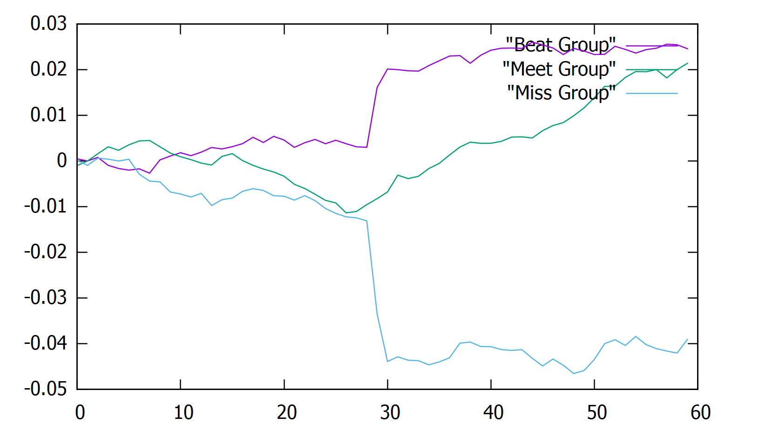
Output & Conclusion

Slide 35
Output & Conclusion
From the plot, we make the conclusion:
-> Stocks in Beat Group, will tend to beat the market in a period of 30 days. Therefor there exists increasing CAAR after Q1 report announced.
-> Stocks in Meet Group, will tend to beat the market as well, but not as much as Group Beat does, their CAAR are lower than the Beat Group.
-> Stocks in Miss Group, will tend to be beaten by the market in the following 30 days, their CAAR drop sharply after Q1 announced.
So we can conclude that, “Surprise” has a huge impact on stock abnormal return after the Quarterly Earnings Report announcement.

Slide 36
Thank You.
Group One
Zhibai Luo, Zicheng He, Yulin Wu,
Xiangjun Kong, Tianzi Zheng
2019-12-17

